Slide 1

WQD 7003 Data Analytics
CHAPTER 7 – MACHINE LEARNING

Slide 2

Outline
Overview and History
Data Terminology
Classification
Regression
Hand-on coding (Lab)

Slide 3
Learning Outcomes
At the end of this lecture, student will be able to:
To explain general concept of machine learning.
To explain machine learning training process
To evaluate the machine learning performance
To implement machine learning model for classification and regression

Slide 4
Machine Learning
Artificial Intelligence
A technique which enables machines to mimic human behaviour
Artificial Intelligence
Machine Learning
Machine Learning
Subset of AI technique which uses statistical methods to enable machines to improve with experience.
Deep Learning
Deep Learning
Subset of Machine Learning which make the computation of multi-layer neural network feasible

Slide 5
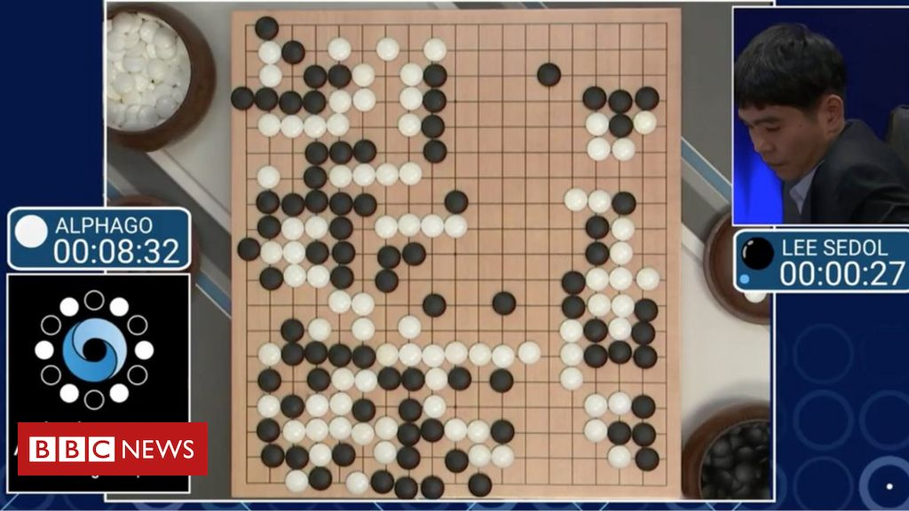
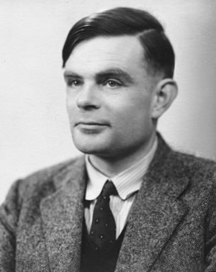
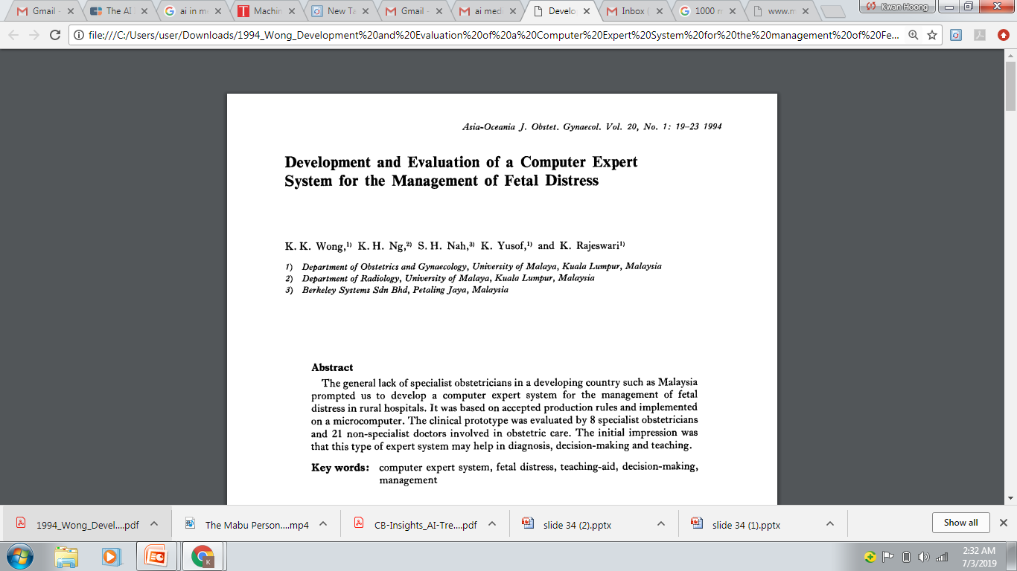
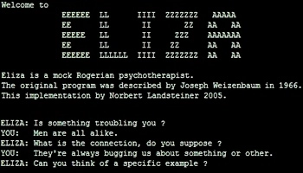

History
“Can machines think?”
Alan Turing introduce a method for machine intelligence
First AI Winter
Second AI Winter
Alpha Go defeated Lee Sedol, world champion of Go
https://www.bbc.com/news/technology-35785875
https://editions.covecollective.org/chronologies/alan-turing-%E2%80%9Ccomputing-machinery-and-intelligence%E2%80%9D-1950
1950
1966
1975
1980
1987
2016
Now
First Chatbot: ELIZA
Expert System
AI in everywhere
https://www.computerhope.com/jargon/e/eliza.htm
Notes:
The history of AI starts very early. In 1950s, at the dawn of computing, Alan Turing asked the question: "Can machines think?“ and he then introduced a method to test machine intelligence. This was at a time when the first general purpose computers had only just been built. In 1966, the first chatbox – ELIZA was built. Unfortunately, AI entered the first winter in 1975 where not much people were interested in such topics and no fundings were available to support this research. In 1980, it started to gain attraction again where expert system were built. In fact, UM also involved in this where they had developed a computer expert system to manage fetal distress. In 1987, AI entered the second winter again because the system was too difficult to maintain, to update and was unable to learn. Until 2016, Alpha GO was announced to defeat Lee Sedol, the world champion of GO. This shows the world how powerful a computer can be. And then, now AI in everywhere, be it in automotive, manufacturing or healthcare.

Slide 6
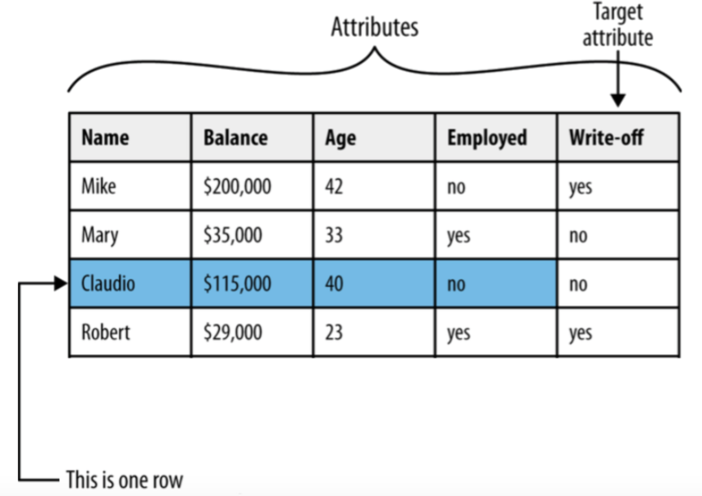
Dataset Terminology

Slide 7
Dataset Terminology
The following terms are used interchangeably:
Row, observation, datapoint
Column, attribute, feature
Target attribute, target, label
A target attribute is one we are interested in predicting

Slide 8
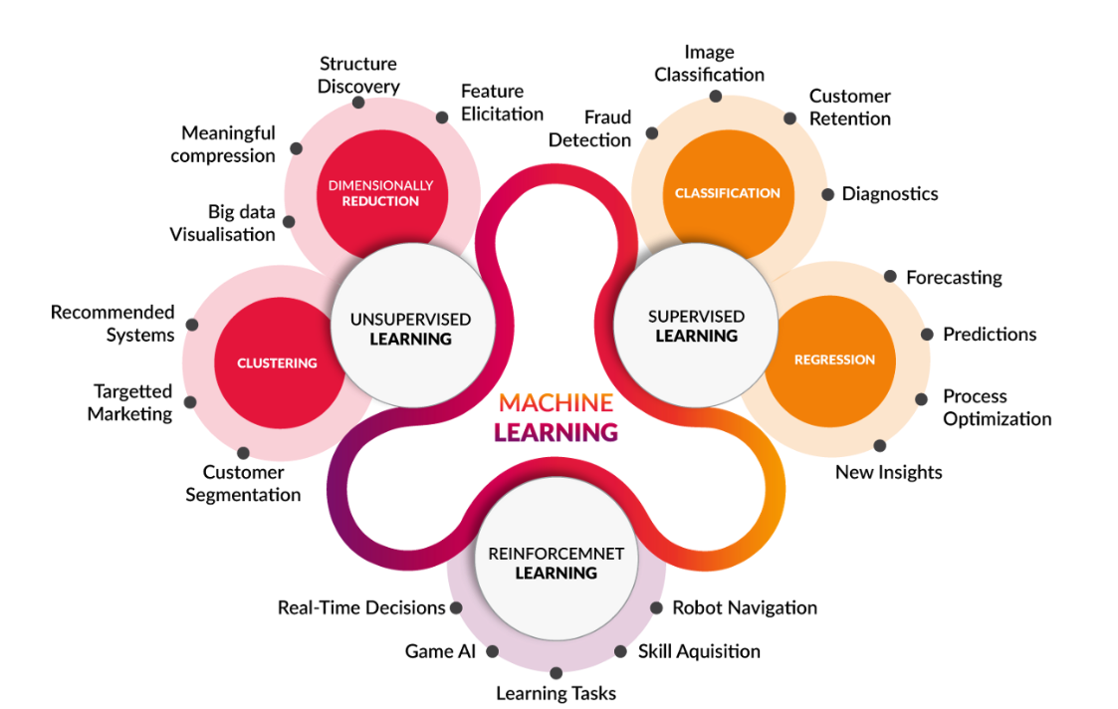
Machine Learning
https://medium.com/@yadavdeepika729/different-machine-learning-models-2387575e64cd

Slide 9
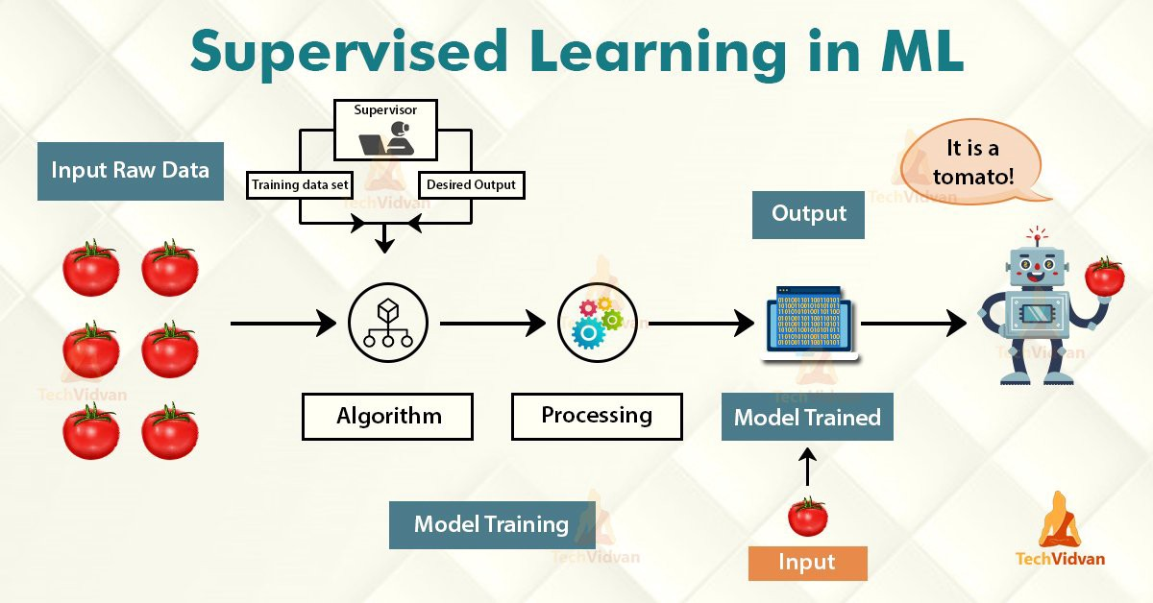
Machine Learning
Have Label
Learn from data pattern
https://medium.com/@yadavdeepika729/different-machine-learning-models-2387575e64cd

Slide 10
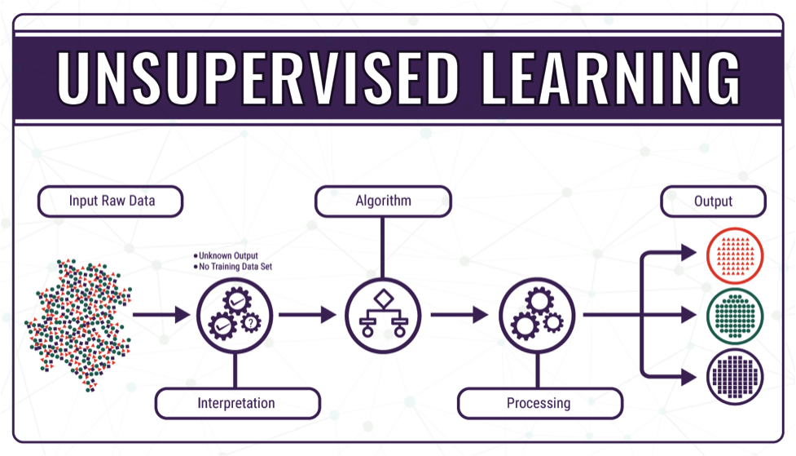
Machine Learning
Do not have label
Group similar data together
https://medium.com/@yadavdeepika729/different-machine-learning-models-2387575e64cd

Slide 11
Machine Learning
https://medium.com/@yadavdeepika729/different-machine-learning-models-2387575e64cd

Slide 12

Classification
Pause and think about some possible example on classification problem.
https://www.springboard.com/blog/data-science/regression-vs-classification/
Notes:
Before go into Machine Learning, we learn on the terminology first.

Slide 13
Classification
Classification is used when the target attribute is a category
Model is built based on target attributes of historical data
Examples: – Predicting churn – Predicting write-off
Notes:
Before go into Machine Learning, we learn on the terminology first.
Churn rate, sometimes known as attrition rate, is the rate at which customers stop doing business with a company over a given period of time.

Slide 14
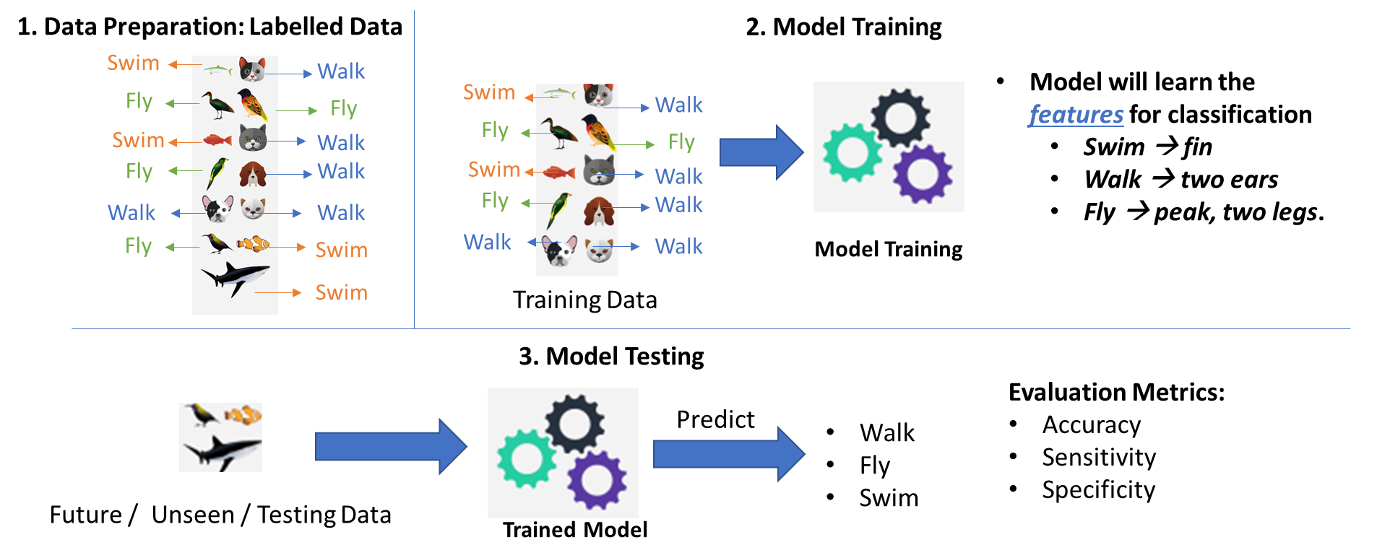
Classification – Developing ML model

Slide 15
Classification – Developing ML model
Data Preparation
Data Splitting (Train/Test)
Data | Feature1 | Feature2 | Prediction | Label
Data1 | 23 | 3 |  | Cold
Data2 | 12 | 51 |  | Hot
Data3 | 1 | 12 |  | Hot
… | … | … |  | …
DataN | 15 | 65 |  | Cold
Model Training
Model Evaluation

Slide 16
Classification – Developing ML model
Data Preparation
Data Splitting (Train/Test)
Data | Feature1 | Feature2 | Prediction | Label
Data1 | 23 | 3 |  | Cold
Data2 | 12 | 51 |  | Hot
Data3 | 1 | 12 |  | Hot
… | … | … |  | …
DataN | 15 | 65 |  | Cold
70%
Training
Model Training
30%
Test
Model Evaluation

Slide 17
Classification – Developing ML model
Data Preparation
Use only training data to train the model
Data Splitting (Train/Test)
Data | Feature1 | Feature2 | Prediction | Label
Data1 | 23 | 3 |  | Cold
Data2 | 12 | 51 |  | Hot
Data3 | 1 | 12 |  | Hot
… | … | … |  | …
DataN | 15 | 65 |  | Cold
70%
Training
Model Training
Model Evaluation

Slide 18
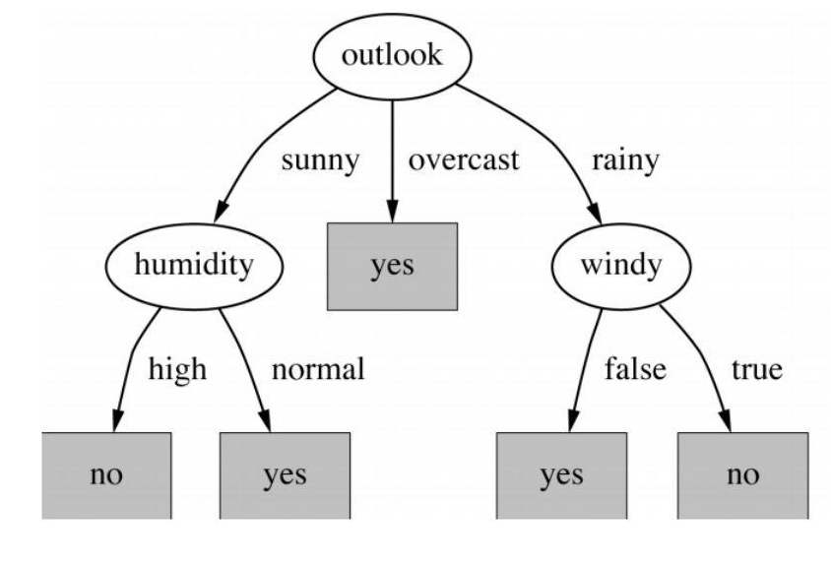
Classification – Developing ML model
Data Preparation
Example of decision tree
Data Splitting (Train/Test)
Model Training
Model Evaluation

Slide 19
ML Model – Classifiers Evaluation Metrics
Data Preparation
Use only testing data to evaluate the model
Data Splitting (Train/Test)
Data | Feature1 | Feature2 | Prediction | Label
Data1 | 23 | 3 | Cold | Cold
Data2 | 12 | 51 | Cold | Hot
Data3 | 1 | 12 | Hot | Hot
… | … | … | … | …
DataN | 15 | 65 | Hot | Cold
Model Training
30%
Test
Model Evaluation
https://en.wikipedia.org/wiki/Confusion_matrix

Slide 20
ML Model – Classifiers Evaluation Metrics
Data Preparation
A perfect model should predict all testing data correctly → Accuracy = 100%
Data Splitting (Train/Test)
Data | Feature1 | Feature2 | Prediction | Label
Data1 | 23 | 3 | Cold | Cold
Data2 | 12 | 51 | Cold | Hot
Data3 | 1 | 12 | Hot | Hot
… | … | … | … | …
DataN | 15 | 65 | Hot | Cold
Model Training
30%
Test
Model Evaluation
https://en.wikipedia.org/wiki/Confusion_matrix

Slide 21
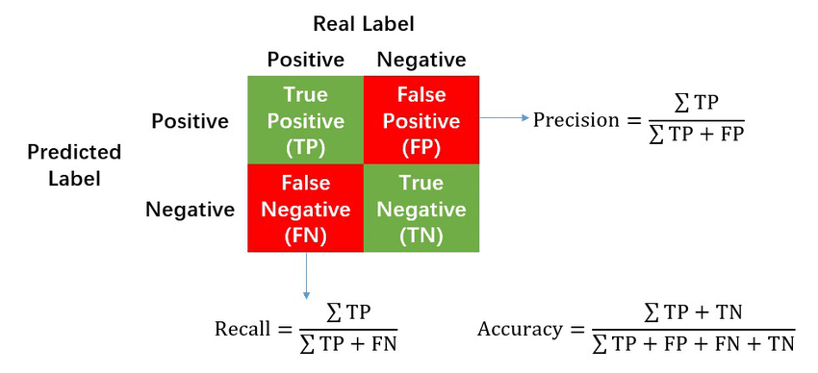
ML Model – Classifiers Evaluation Metrics
Data Preparation
Confusion Matrix
Data Splitting (Train/Test)
Model Training
Model Evaluation
https://en.wikipedia.org/wiki/Confusion_matrix

Slide 22
ML Model – Classifiers Evaluation Metrics
Accuracy: How many % of predicted cases are correct.
Precision: How many % of predicted positive cases are actually positive
Recall: How many % of positive cases did the classifier predict as positive?
F measure (F₁ or F-score): harmonic mean of precision and recall.
Perfect score is 1.0

Slide 23
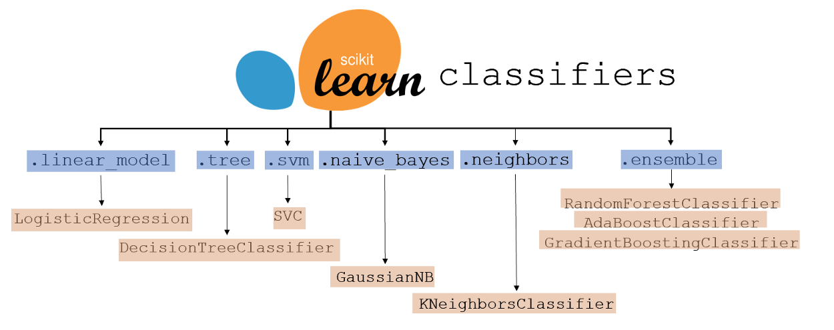
ML Model – Other types of classifiers
https://www.kdnuggets.com/2021/01/ultimate-scikit-learn-machine-learning-cheatsheet.html

Slide 24
Machine Learning
https://medium.com/@yadavdeepika729/different-machine-learning-models-2387575e64cd

Slide 25
Regression
Pause and think about some possible example on regression problem.
https://www.springboard.com/blog/data-science/regression-vs-classification/
Notes:
Before go into Machine Learning, we learn on the terminology first.

Slide 26
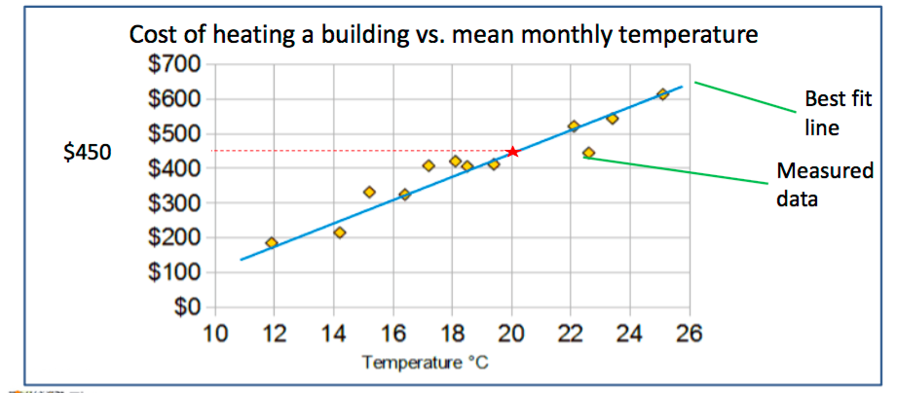
Regression
Regression predicts a target attribute which is a number (as opposed to a category)
The simplest regression is a best fit line
Notes:
Before go into Machine Learning, we learn on the terminology first.

Slide 27
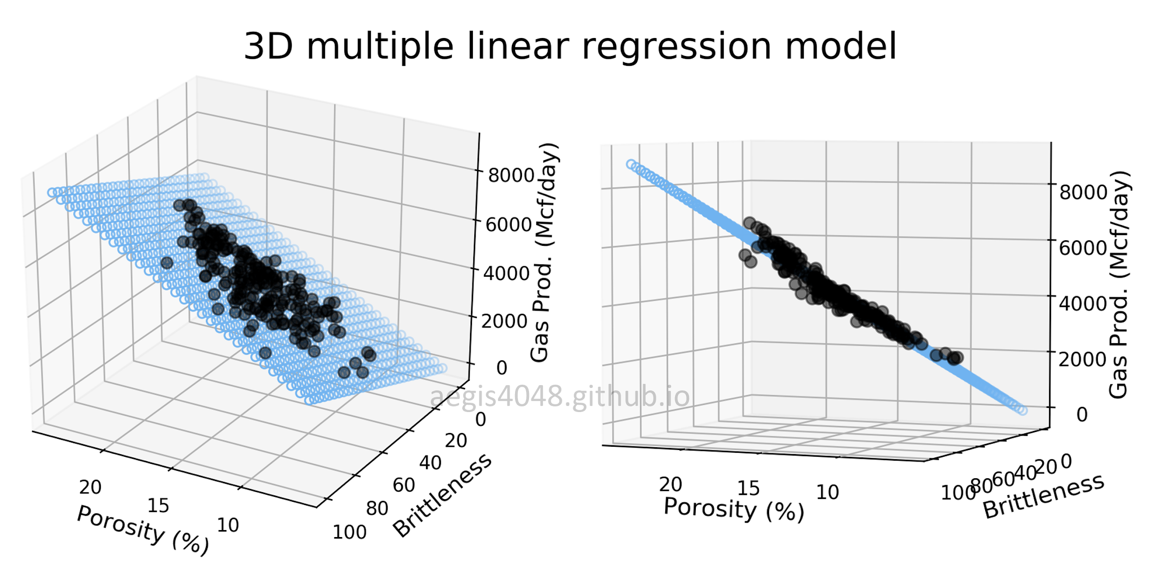
Regression
https://aegis4048.github.io/mutiple_linear_regression_and_visualization_in_python

Slide 28
Regression – Developing ML model
Data Preparation
Data Splitting (Train/Test)
Data | Feature1 | Feature2 | Prediction | Temp.
Data1 | 23 | 3 |  | 32
Data2 | 12 | 51 |  | 29
Data3 | 1 | 12 |  | 24
… | … | … |  | …
DataN | 15 | 65 |  | 38
Model Training
Model Evaluation

Slide 29
Regression – Developing ML model
Data Preparation
Data Splitting (Train/Test)
Data | Feature1 | Feature2 | Prediction | Temp.
Data1 | 23 | 3 |  | 32
Data2 | 12 | 51 |  | 29
Data3 | 1 | 12 |  | 24
… | … | … |  | …
DataN | 15 | 65 |  | 38
70%
Training
Model Training
30%
Test
Model Evaluation

Slide 30
Regression – Developing ML model
Data Preparation
Use only training data to train the model
Data Splitting (Train/Test)
Data | Feature1 | Feature2 | Prediction | Temp.
Data1 | 23 | 3 |  | 32
Data2 | 12 | 51 |  | 29
Data3 | 1 | 12 |  | 24
… | … | … |  | …
DataN | 15 | 65 |  | 38
70%
Training
Model Training
Model Evaluation

Slide 31
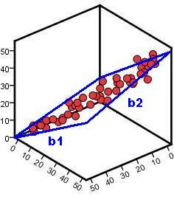
Regression – Developing ML model
Data Preparation
Example of linear regression
Data Splitting (Train/Test)
Temperature
Model Training
Model Evaluation
Feature 1
Feature 2

Slide 32
ML Model – Regression Evaluation Metrics
Data Preparation
Use only testing data to evaluate the model
Data Splitting (Train/Test)
Data | Feature1 | Feature2 | Prediction | Label
Data1 | 23 | 3 | 34 | 32
Data2 | 12 | 51 | 31 | 29
Data3 | 1 | 12 | 26 | 24
… | … | … | … | …
DataN | 15 | 65 | 35 | 38
Model Training
30%
Test
Model Evaluation
https://en.wikipedia.org/wiki/Confusion_matrix

Slide 33
ML Model – Regression Evaluation Metrics
Data Preparation
A perfect model should predict all testing data correctly→ Mean Square Error = 0
Data Splitting (Train/Test)
Data | Feature1 | Feature2 | Prediction | Label
Data1 | 23 | 3 | 34 | 32
Data2 | 12 | 51 | 31 | 29
Data3 | 1 | 12 | 26 | 24
… | … | … | … | …
DataN | 15 | 65 | 35 | 38
Model Training
30%
Test
Model Evaluation

Slide 34
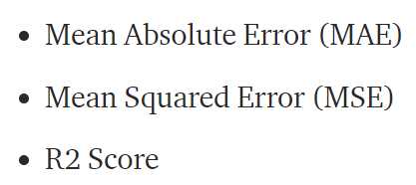
ML Model – Regression Evaluation Metrics
Data Preparation
Data Splitting (Train/Test)
Model Training
Model Evaluation
https://medium.com/@parag.jain164/performance-matrix-for-regression-model-c9ba0d2cae33

Slide 35
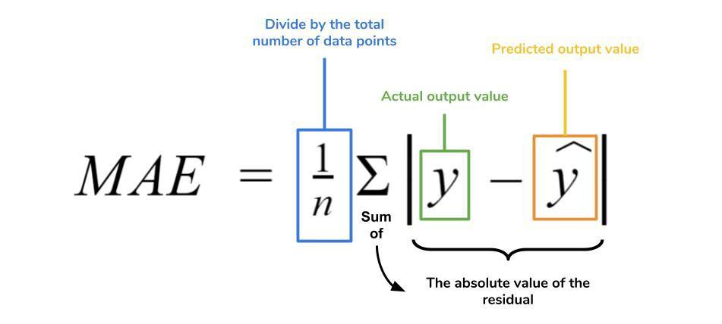
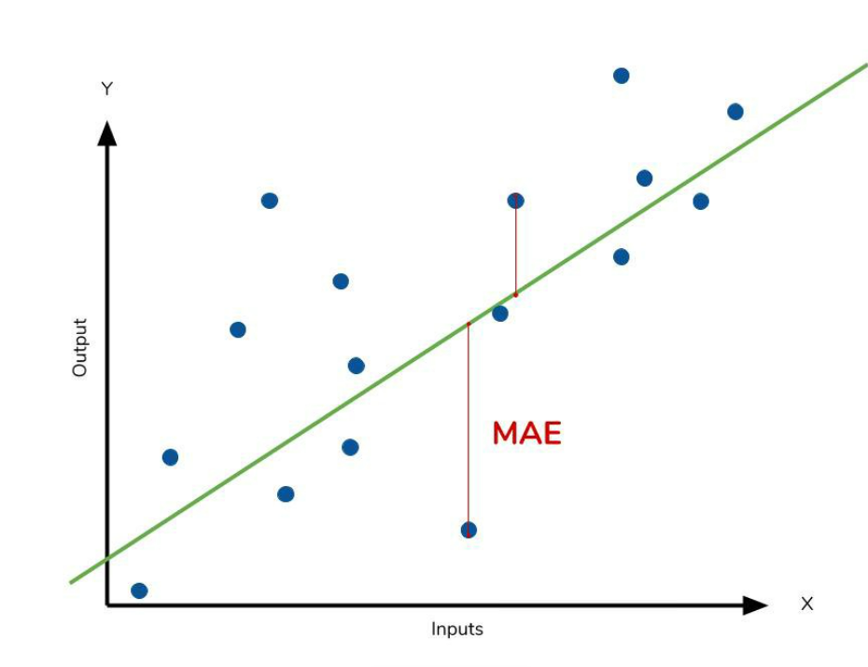
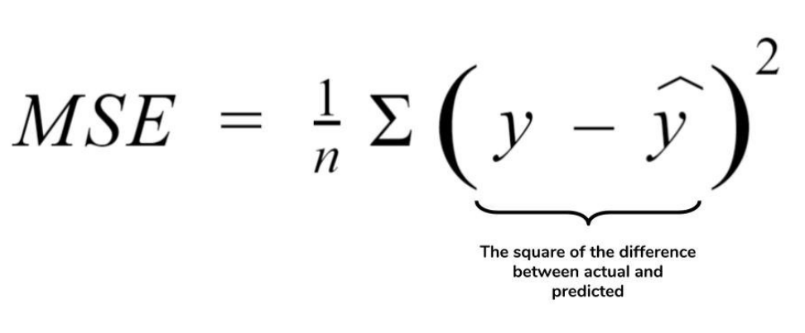
ML Model – Regression Evaluation Metrics
Data Preparation
Data Splitting (Train/Test)
Model Training
Model Evaluation
https://medium.com/ml-cheat-sheet/machine-learning-evaluation-metrics-b89b8832e275

Slide 36
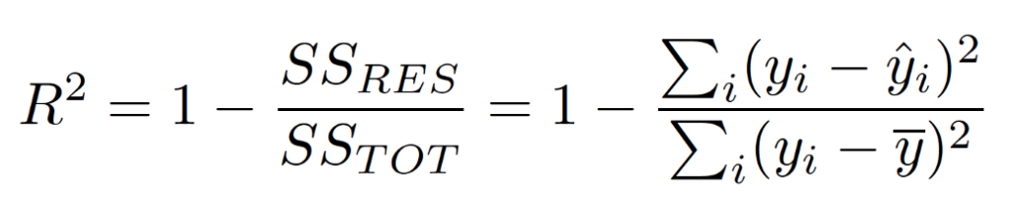
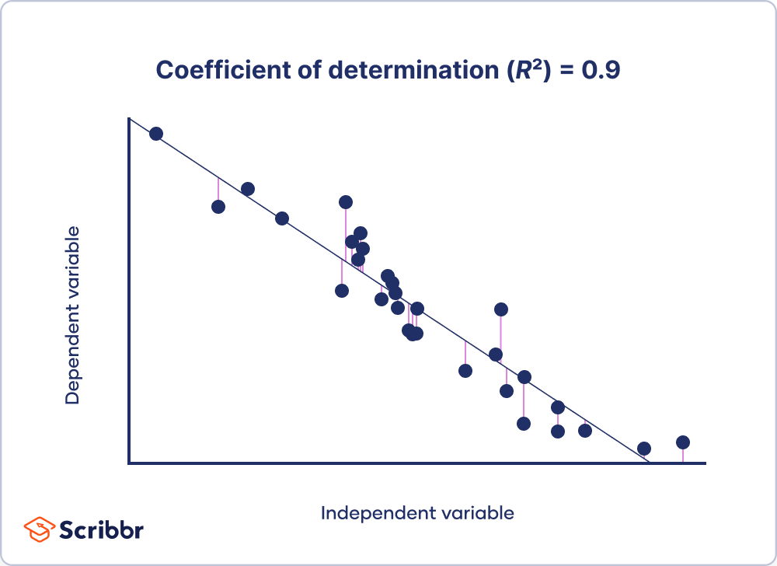
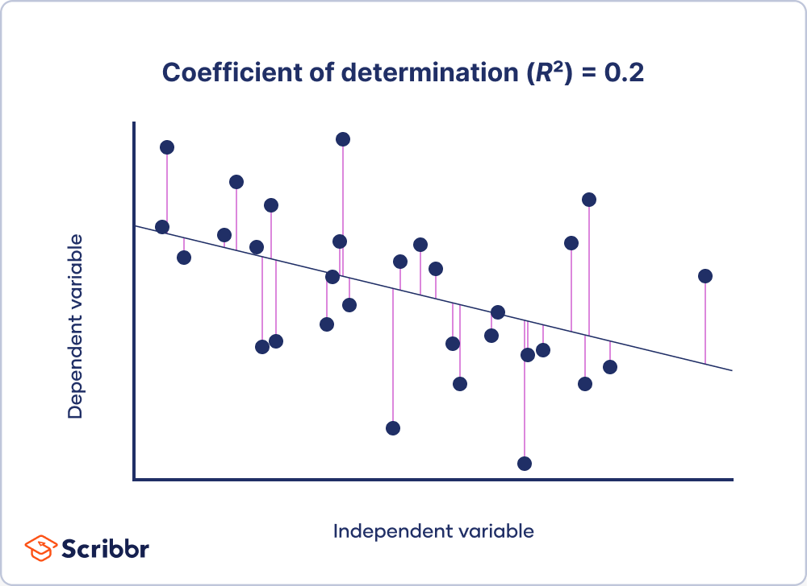
ML Model – Regression Evaluation Metrics
Data Preparation
Data Splitting (Train/Test)
Model Training
Model Evaluation
https://www.scribbr.com/statistics/coefficient-of-determination/

Slide 37
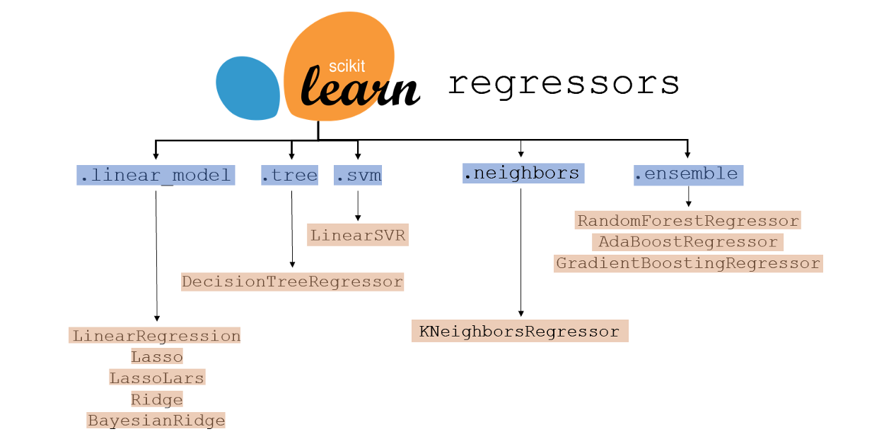
ML Model – Other types of regressor
https://www.kdnuggets.com/2021/01/ultimate-scikit-learn-machine-learning-cheatsheet.html

Slide 38
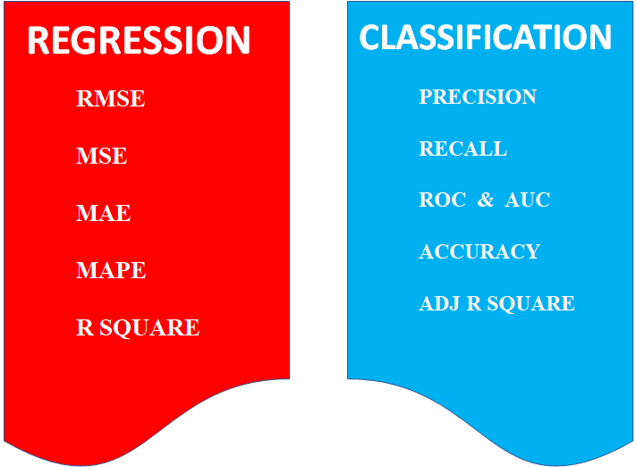
ML Model – Evaluation Metrics
https://medium.com/odscjournal/are-we-choosing-the-right-evaluation-metrics-how-to-choose-it-ee01fcf34b9

Slide 39
Corresponding Code
Data Preparation
pd.read_csv()
Data Splitting (Train/Test)
sklearn.model_selection.train_test_split()
Model Training
model.fit()
Model Evaluation
model.predict()

Slide 40
Example – Nearest Neigbours

Slide 41
Nearest Neighbour Classifiers
Basic idea:
If it walks like a duck, quacks like a duck, then it’s probably a duck
Compute Distance
Test Record
Training Records
Choose k of the “nearest” records

Slide 42
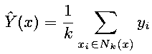
Nearest Neighbour Classifiers
Majority vote within the k nearest neighbors
new
K= 1: dark green
K= 3: green

Slide 43
Nearest Neighbour Classifiers
Requires three things
The set of stored records
Distance Metric to compute distance between records
The value of k, the number of nearest neighbors to retrieve
To classify an unknown record:
Compute distance to other training records
Identify k nearest neighbors
Use class labels of nearest neighbors to determine the class label of unknown record (e.g., by taking majority vote)

Slide 44
Nearest Neighbour Classifiers
K-nearest neighbors of a record x are data points that have the k smallest distance to x

Slide 45
Nearest Neighbour Classifiers
Compute distance between two points:
Euclidean distance
Determine the class from nearest neighbor list
take the majority vote of class labels among the k-nearest neighbors
Weigh the vote according to distance
weight factor, w = 1/d²

Slide 46

K-Nearest Neighbour (KNN) Classifiers

